Slide 1
Google Data analytics Capstone
Case Study: How Does a Bike-Share Navigate Speedy Success?
Created by: Ahmed Marsaoui
Date: June, 2022

Slide 2
Outline
Introduction
Methodology
Defining objectives
Data sources
EDA and data manipulation
Data analysis
Data visualization
Results
Conclusion

Slide 3
Introduction
The bike share program « Cyclistic » is more and more popular
Goals differ from one user to another within Chicago city
Two main users categories with different trends:
Casual riders
Cyclistic members
The second category generates more profit thanks to their annual membership
Need of the difference study to help convert casual riders
into annual members

Slide 4
Methodology
Based on the data analysis process: Ask, prepare, process, analyse, share and act
Each step is linked into one part from those mentioned in the introduction
The use of python for Data analyses
The use of python for the Data visualization
The use of Github as the sharing medium of the obtained results

Slide 5
ASK: Defining the projects’ objectives
Analyzing the riders’ usage patterns to distinguish main differences
Document All data sources and their EDA
Results must be clearly visualized
Recommendation will be delivered to help define the membership conversion program
Key stakeholders include: Cyclistic executive team, Director of Marketing (Lily Moreno), Marketing Analytics team.

Slide 6
PREPARE: Data sources
Use of a public data source
A csv file with 13 columns and 551 480 registrations
Fields’ types are: Strings, dates and floats including the rider type (casual/ member)
Data credibility : Due to the fact that this is a case study using public data, we are going to assume the data is credible.

Slide 7
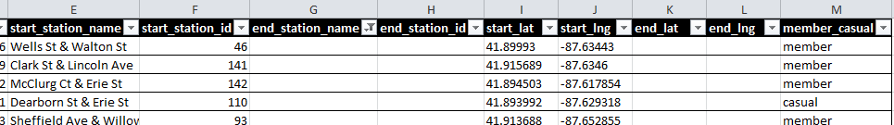
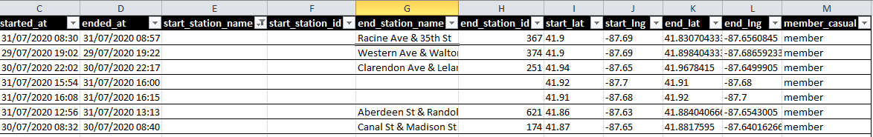
Process: EDA and data manipulations (1)
Use of:
spreadsheet for direct data exploration
Python for its advanced EDA operations
Empty cells occurs in the Start and End stations of each ride

Slide 8
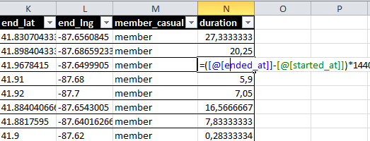
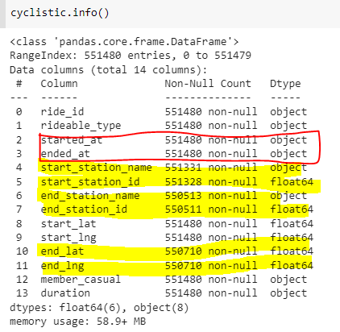
Process: EDA and data manipulations (2)
Adding a relevant columns: duration of the Trip
Getting a closer look on the
Dataframe o confirm the missing data

Slide 9
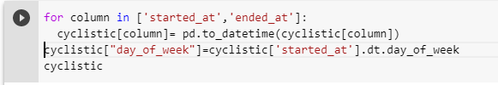
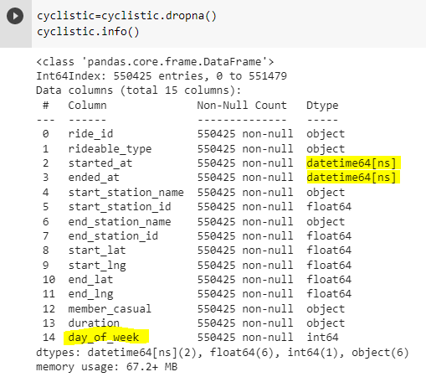
Process: EDA and data manipulations (3)
Converting the start and end dates into datetime variable
Adding a day of the week column for later user
Deleting rows with missing data (best approach since the dataset is large enough to analyze without them)
New samples: 550 425

Slide 10
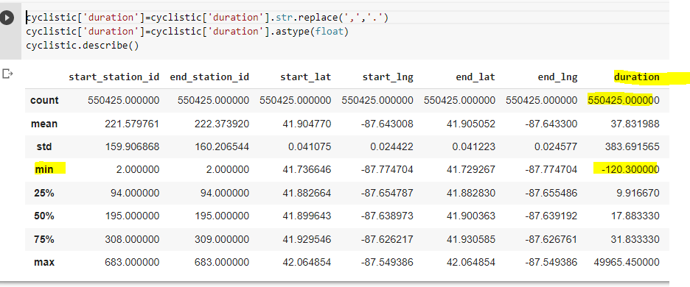
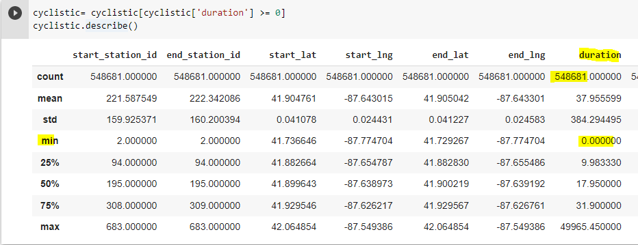
Analyse: Calculations (1)
Negative duration will be dropped, dataset size changed

Slide 11
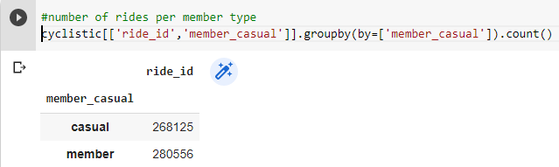
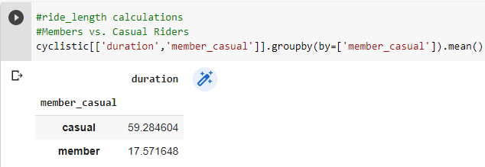
Analyse: Calculations (2)

Slide 12
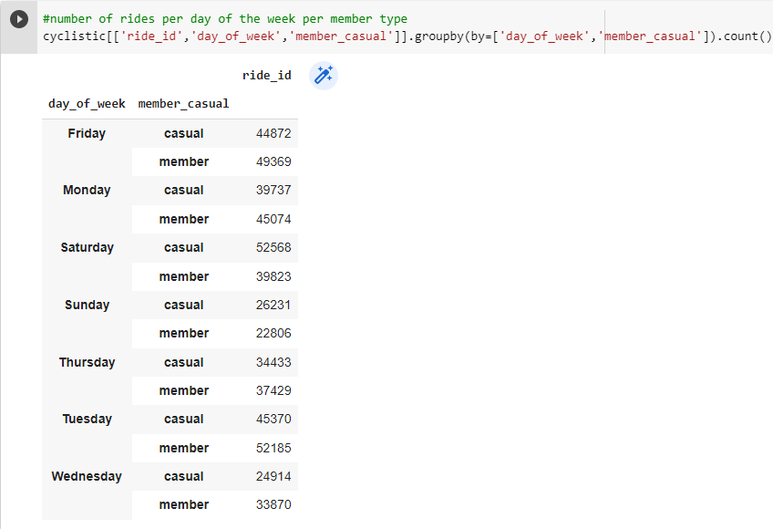
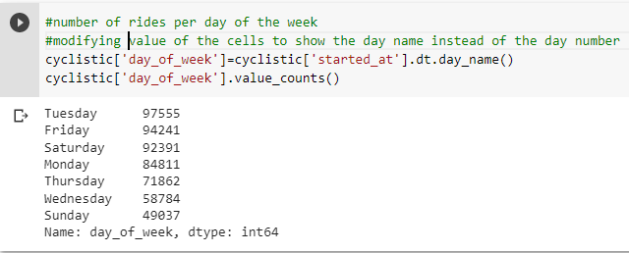
Analyse: Calculations (3)

Slide 13
Analyse: Identify trends and relationships
Although that the number of rides executed by the subscribed members is higher, the rides of casual members is 3,5 longer (sightseeing vs regular trip from an to work/ school)
Except for Tuesday, the rides number increases on both Friday and Saturday and decline dramatically on Sunday

Slide 14
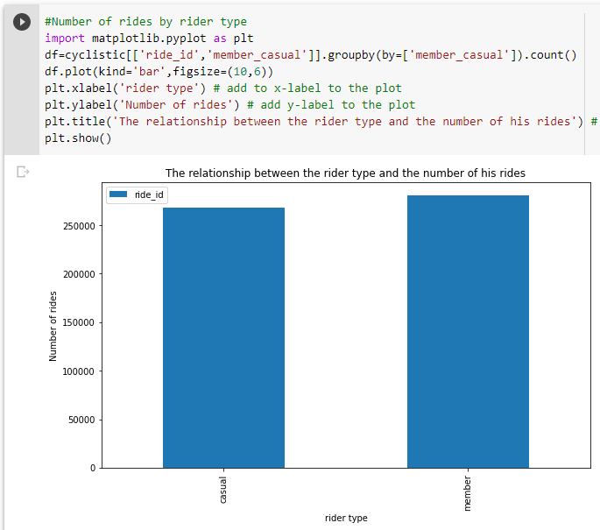
Share: Data visualisation

Slide 15
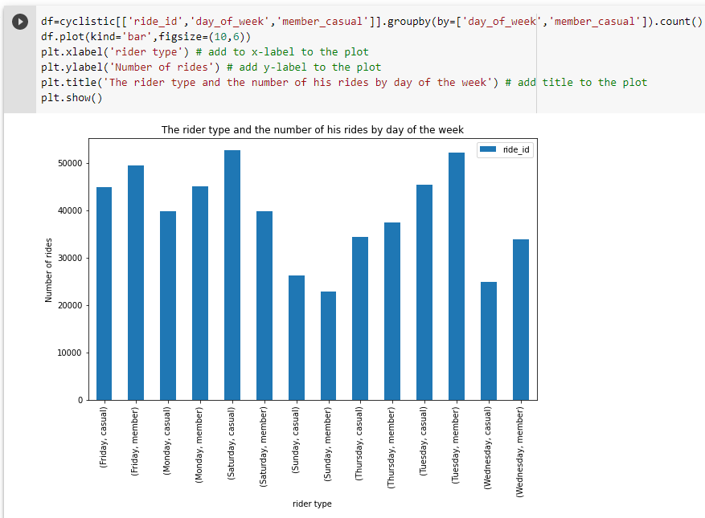

Slide 16
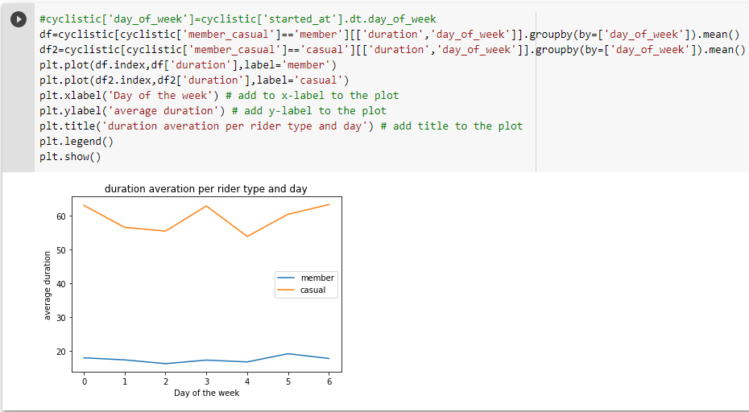

Slide 17
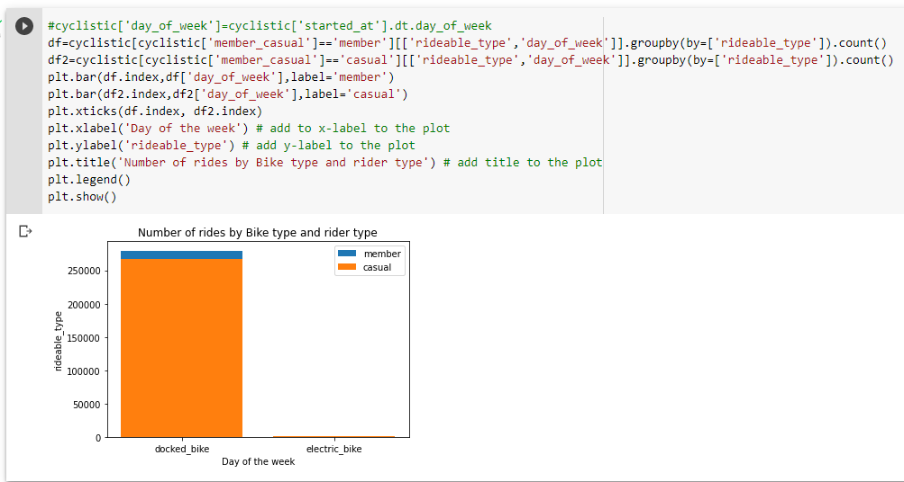

Slide 18
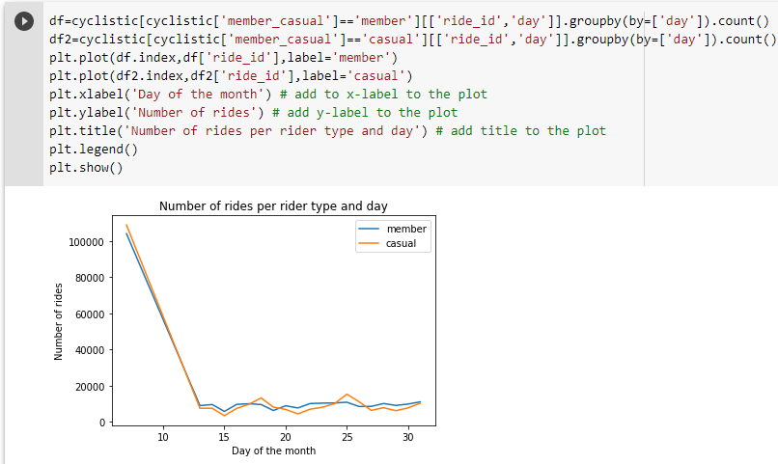

Slide 19
Results: Present your findings
A ride lasts on average about 37 min (18 min for members and 60 min for casuals)
The most popular days are Tuesday and Saturdays
Sunday is the least day for rides numbers
A casual ride last about 3,5 times than a member ride all week
The docked Bike is still far more popular than the electric one
Both riders rent bikes with same cadency (Max is on the first 10 days of the month) : This can be explained by the weather conditions relative to the month of the study (snow begins on the third week of April, 2020)

Slide 20
Act: conclusion (1)
Main objective: Discover behavioral difference between members and casuals riders to gain the latters loyalty
Members uses bikes either for work or school since there is no variation in the number of rides over the days contrary to tha casuals
The pick of use for casuals is on the weekends (Saturdays)

Slide 21
Act: conclusion (2)
My three recommendations are:
Launch a specific weekend only membership with a lower price than the annual memberships
Launch campaigns on sunny months (Spring, summer) to avoid severe weather conditions such as Wind, Snow and rain to maximize interaction
As casual riders rent as they go, offering them sightseeing pragmas with the city monuments and sights could be a great type of casuals memberships.

